Slide 1
Welcome to the Steve & Shari Sadek Family
Camp Interlaken JCC!

Slide 2
Toni Davison Levenberg
Camp Director
tdavison@jccmilwaukee.org
Holly White
Camping Services Coordinator hwhite@jccmilwaukee.org
Randy “Grizz” Comensky
Assistant Director
rcomensky@jccmilwaukee.org
Tova Blasberg
Assistant Director
tblasberg@jccmilwaukee.org
Michelle Lafferty
Social Worker
mlafferty@jccmilwaukee.org
Toni Davison Levenberg
Camp Director
tdavison@jccmilwaukee.org
Mark Gutman
Assistant Director
mgutman@jccmilwaukee.org
Stephanie Wezelman
Program Director
swezelman@jccmilwaukee.org
Michelle Lafferty
Social Worker
mlafferty@jccmilwaukee.org
Beth Alling Camping Services Coordinator -
balling@jccmilwaukee.org
Summer: 715-479-8030 (June 4th — August 24th)
Year Round: 414-967-8240
http://www.campinterlaken.org
Toni Davison Levenberg
Camp Director
tdavison@jccmilwaukee.org
Mark Gutman
Assistant Director
mgutman@jccmilwaukee.org
Stephanie Wezelman
Program Director
swezelman@jccmilwaukee.org
Michelle Lafferty
Social Worker
mlafferty@jccmilwaukee.org
Beth Alling Camping Services Coordinator -
balling@jccmilwaukee.org
Summer: 715-479-8030 (June 4th — August 24th)
Year Round: 414-967-8240
http://www.campinterlaken.org

Slide 3
New Camper Orientation
1. Welcome
2. Preparing for camp
A. Getting ready
B. Packing
3. On the Move: Bus Departure & Luggage
4. A Day in the life of a CIL Camper
5. Chugim
6. Health & Safety
A. Medications
B. Taking Care of Yourselves
C. MESH
8. Communication with your campers
9. Campanion
10. Canteen
11. Judaism at Camp
12. Final Questions

Slide 5
Make Your Bed

Slide 6
Make Your Bed

Slide 7
More Cabins

Slide 8
Taking Care of Yourself

Slide 9
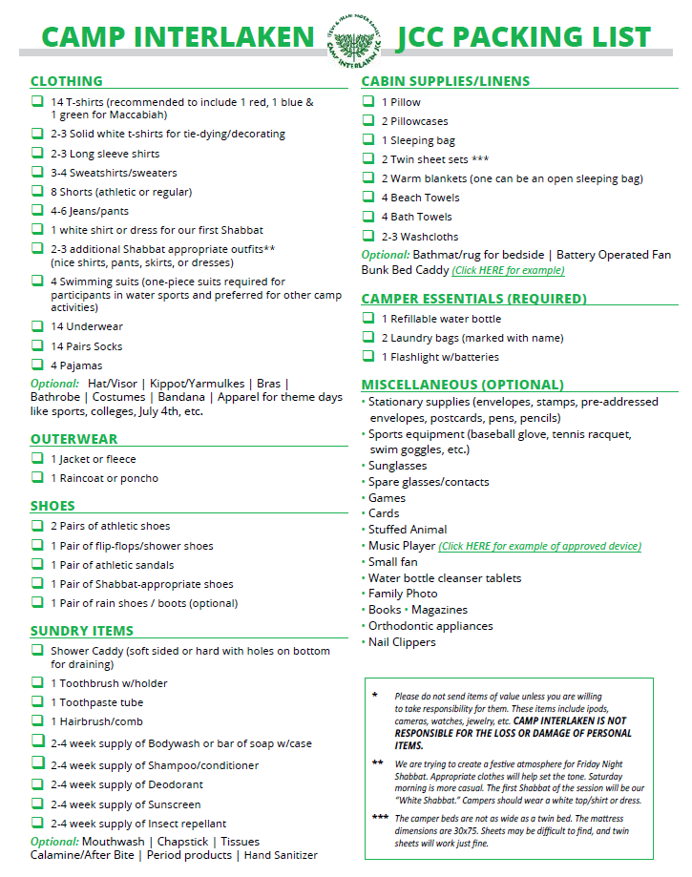

Slide 10
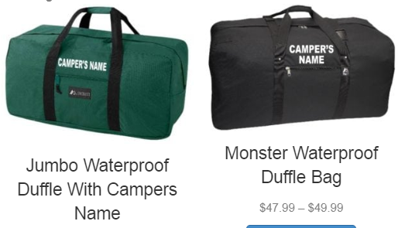
Toni’s Favorite Things
Duffle Bag
https://www.brodysonline.com/brodys-camping-travel-goods?page=6

Slide 11
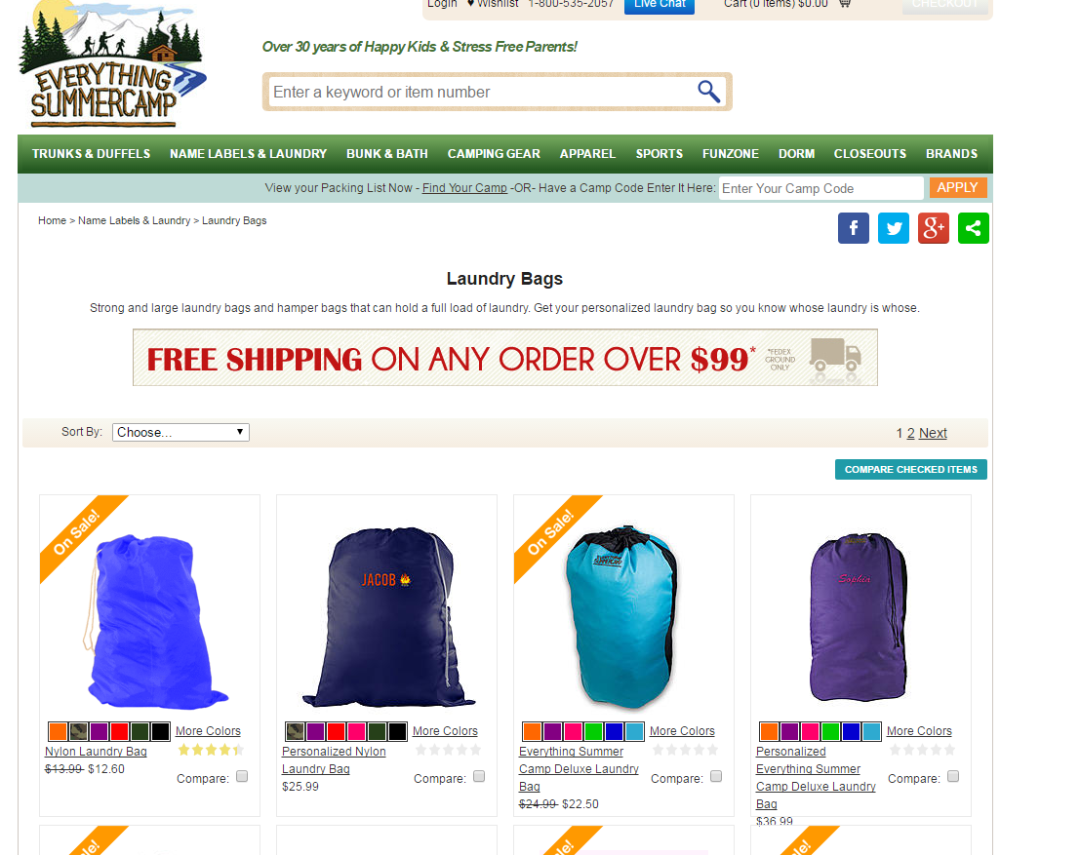
Laundry

Slide 12
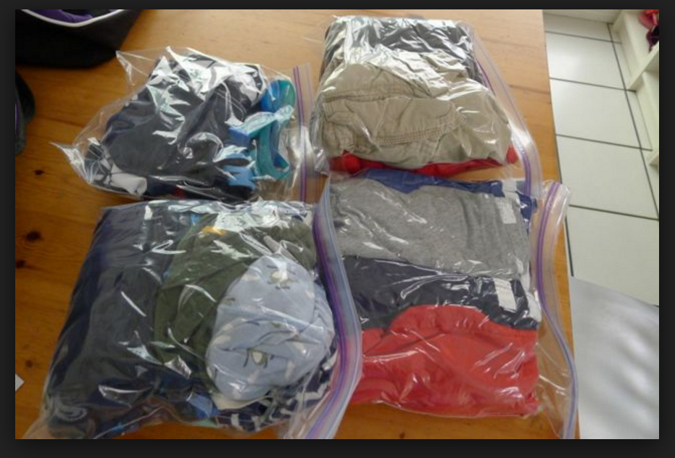
Toni’s Favorite Things
Packing in ZipLoc Bags

Slide 13
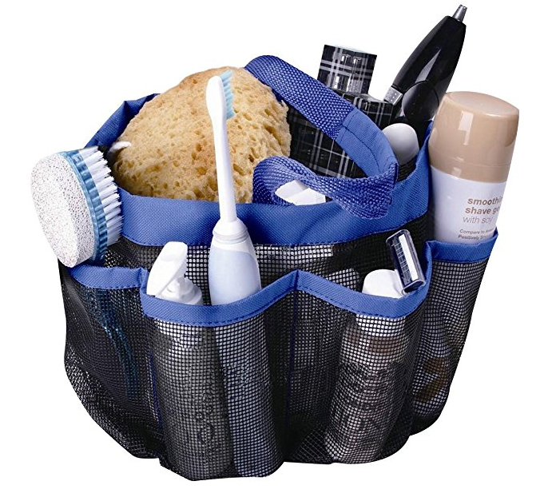
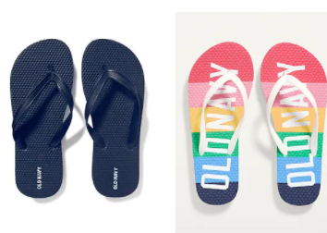
Toni’s Favorite Things
Shower Caddy
Shower Shoes

Slide 14
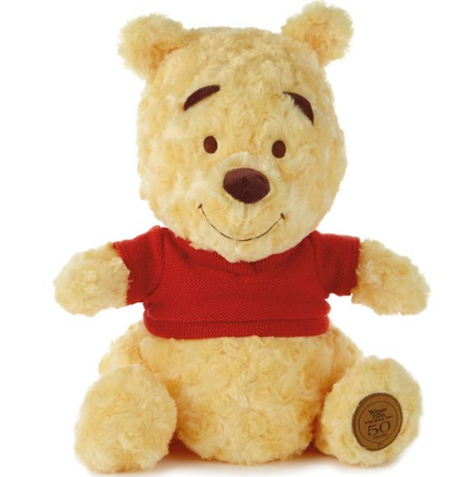
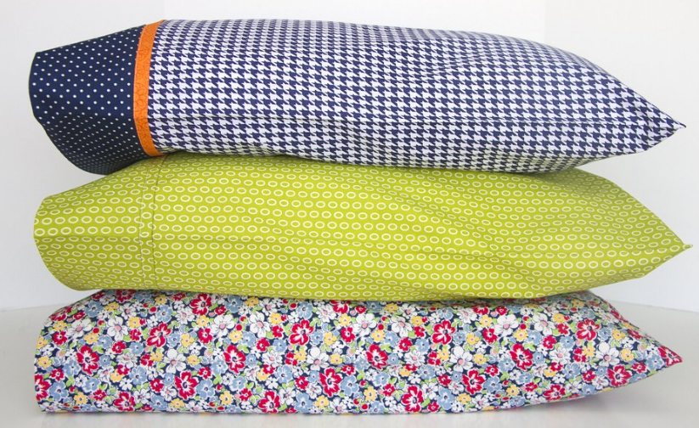
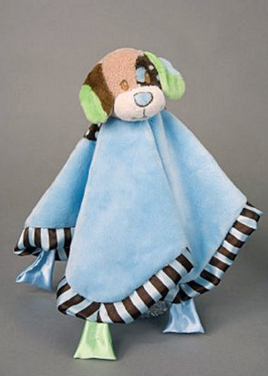
Toni’s Favorite Things
Lovies & Stuffed Animals

Slide 15
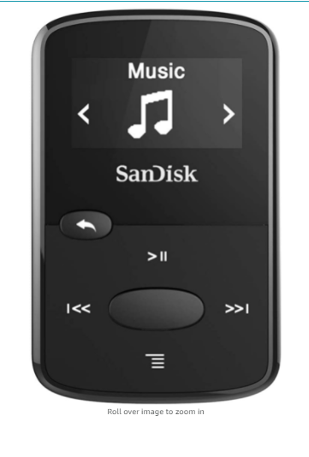
Toni’s Favorite Things
Music & mp3 Players
https://www.amazon.com/s?k=small+mp3+player&crid=22BNCH58CNR29&sprefix=small+mp3+pla%2Caps%2C107&ref=nb_sb_noss_2

Slide 16
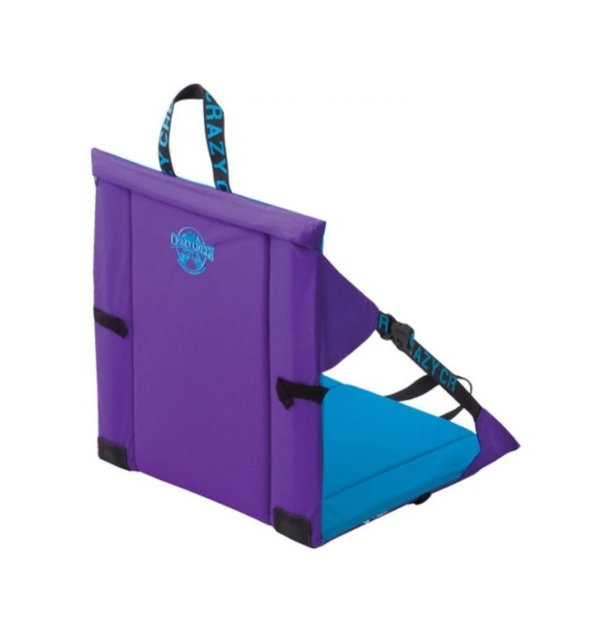
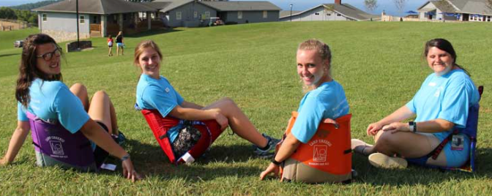
Toni’s Favorite Things
Crazy Creeks
https://www.crazycreek.com/

Slide 17
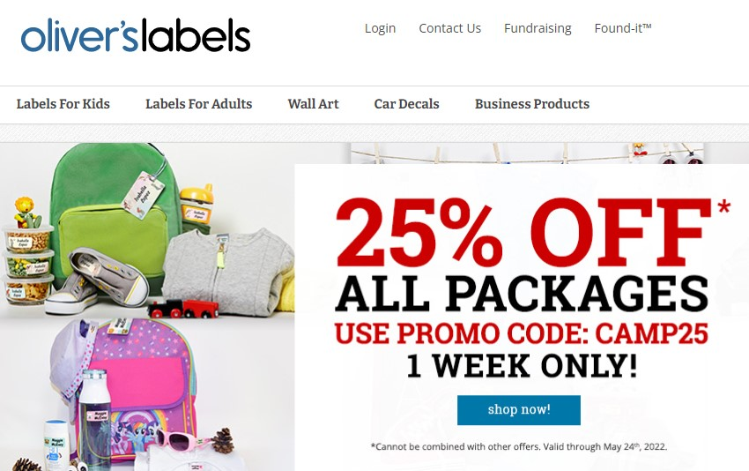
Toni’s Favorite Things
Labels & Stamps & Sharpies

Slide 18
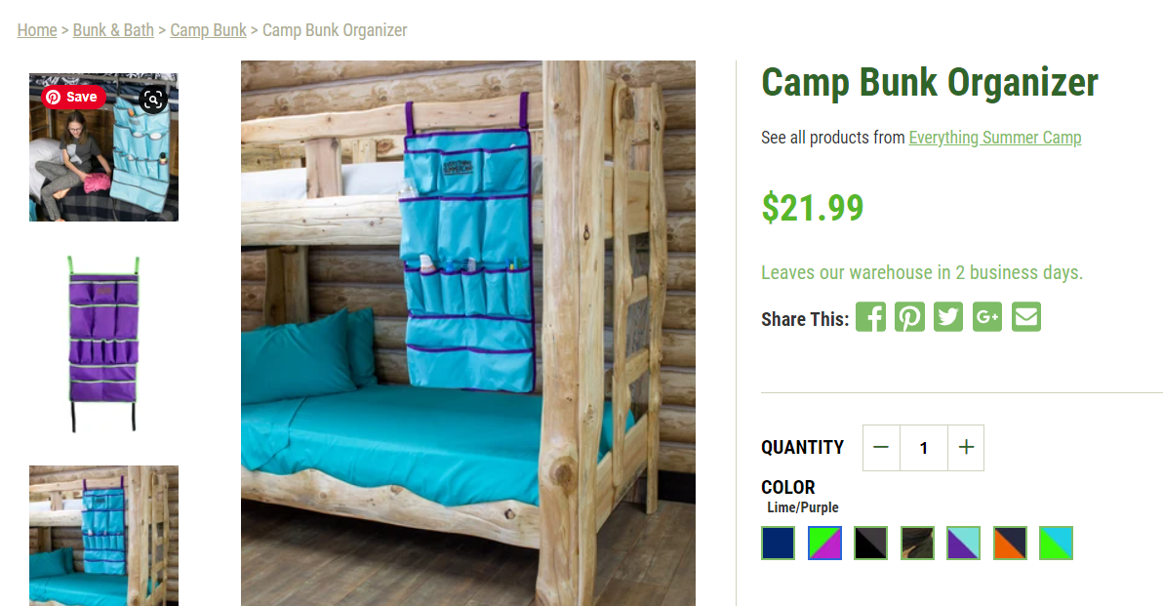
Bunk Bed Caddy
https://everythingsummercamp.com/collections/camp-bunk/products/c-n-camp-bunk-organizers?variant=40739891609715

Slide 19
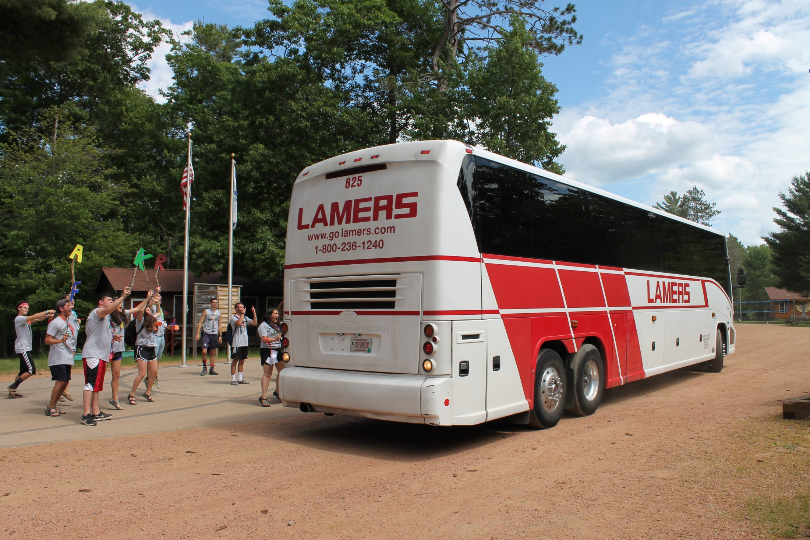

Slide 20
Luggage
First session
Madison – luggage under bus
MKE – luggage loading the night before
IL – luggage under bus
Second Session
MKE – luggage loading the night before
IL – luggage under bus

Slide 21
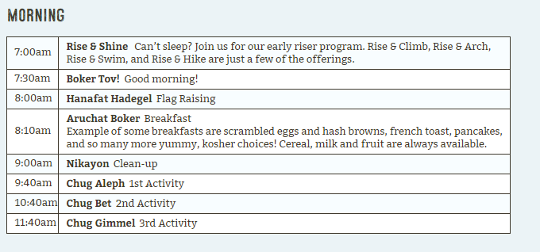

Slide 22
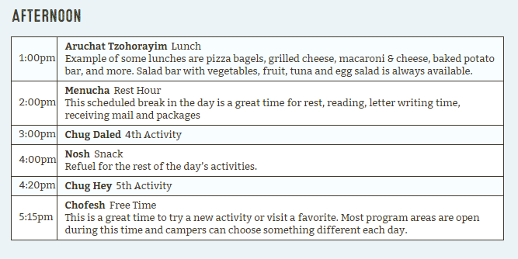

Slide 23
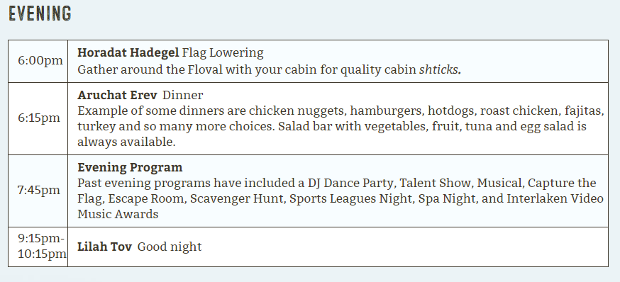

Slide 24
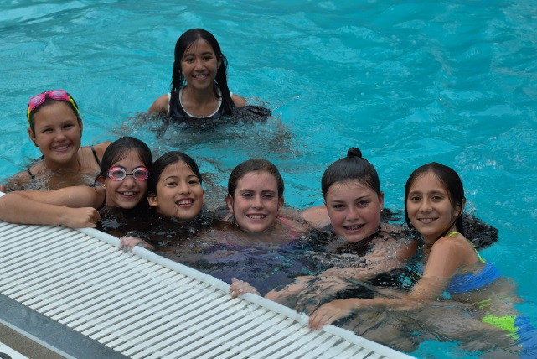
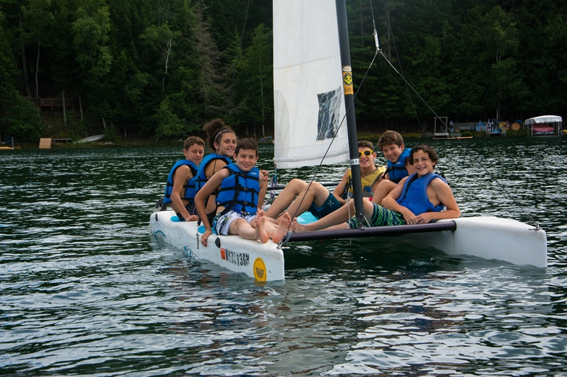
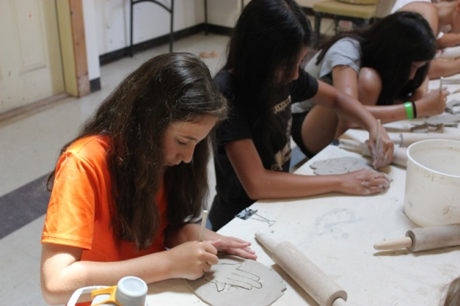
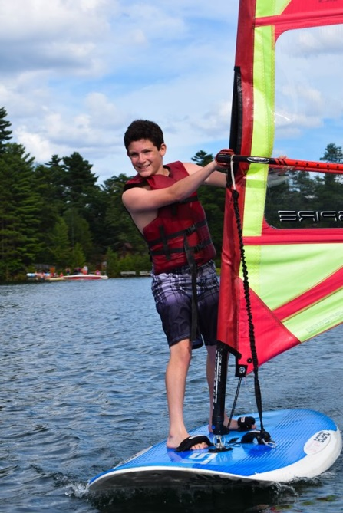
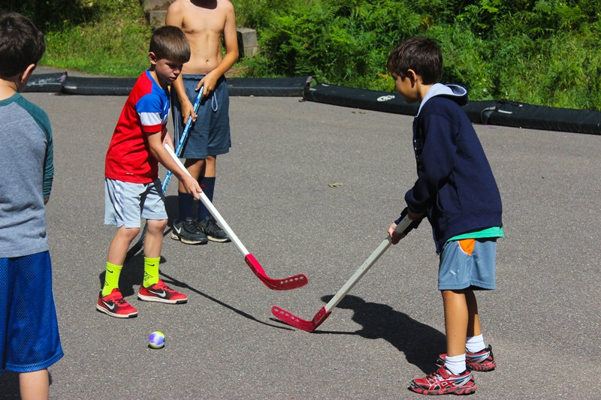
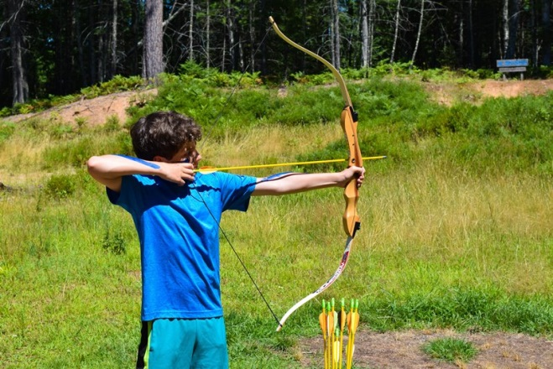
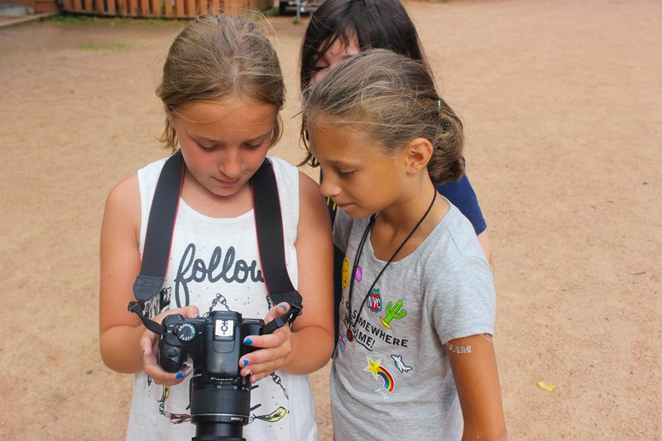
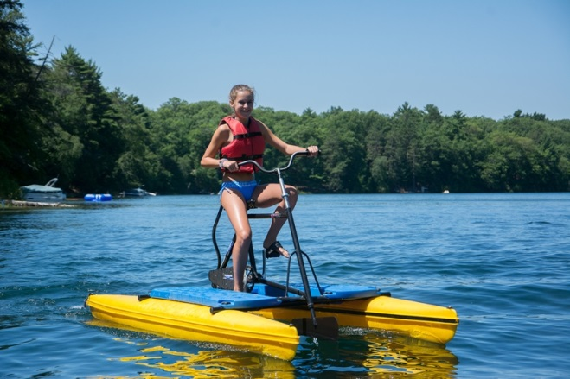
Activities

Slide 26
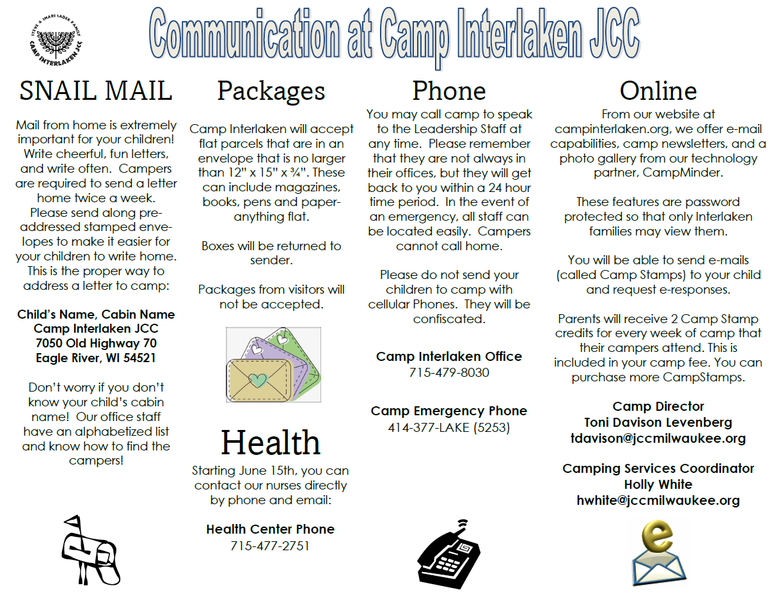

Slide 28
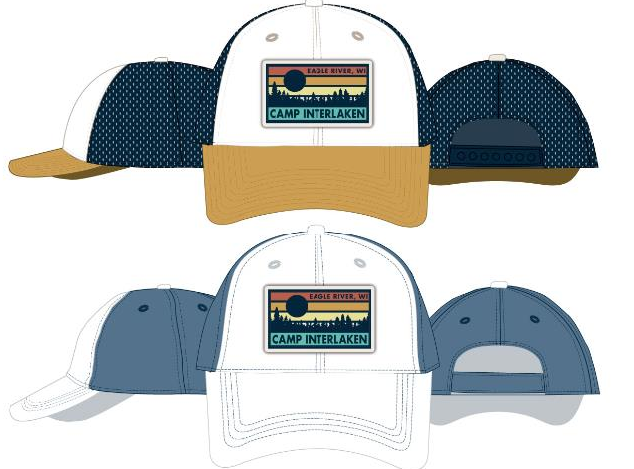
Canteen

Slide 30
